Slide 1






Medicare Updates for 2025
v

Slide 2
Hot Topics
New drug coverage MOOP
Part D – Medicare Prescription Payment Plan (MPPP)
SEP – Low Income
Telehealth Changing
Postal Service Retirees (i.e. annuitants)

Slide 3
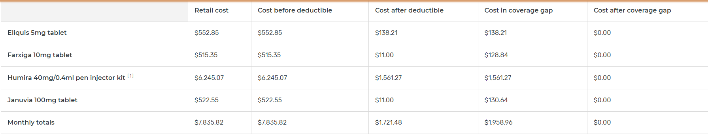
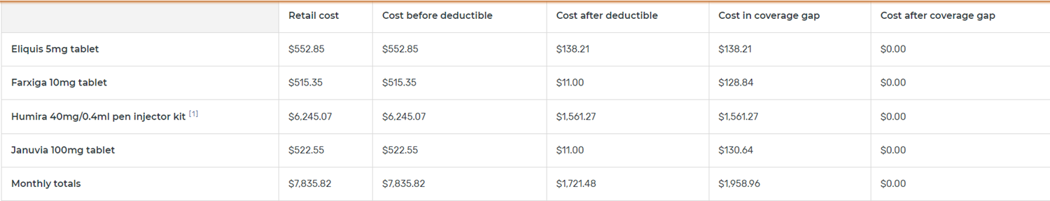

Bye Bye Donut Hole!
2024
2025

Slide 4
Hello lower MOOP!
Overview of Changes to the Part D Benefit: In CY 2025, the structure of the Part D benefit is updated to reflect provisions of the IRA that become effective on January 1, 2025. The CY 2025 updates include the following:
− A newly defined standard Part D benefit design consisting of three phases: annual deductible, initial coverage, and catastrophic coverage;
− A lower annual out-of-pocket (OOP) threshold of $2,000;

Slide 5
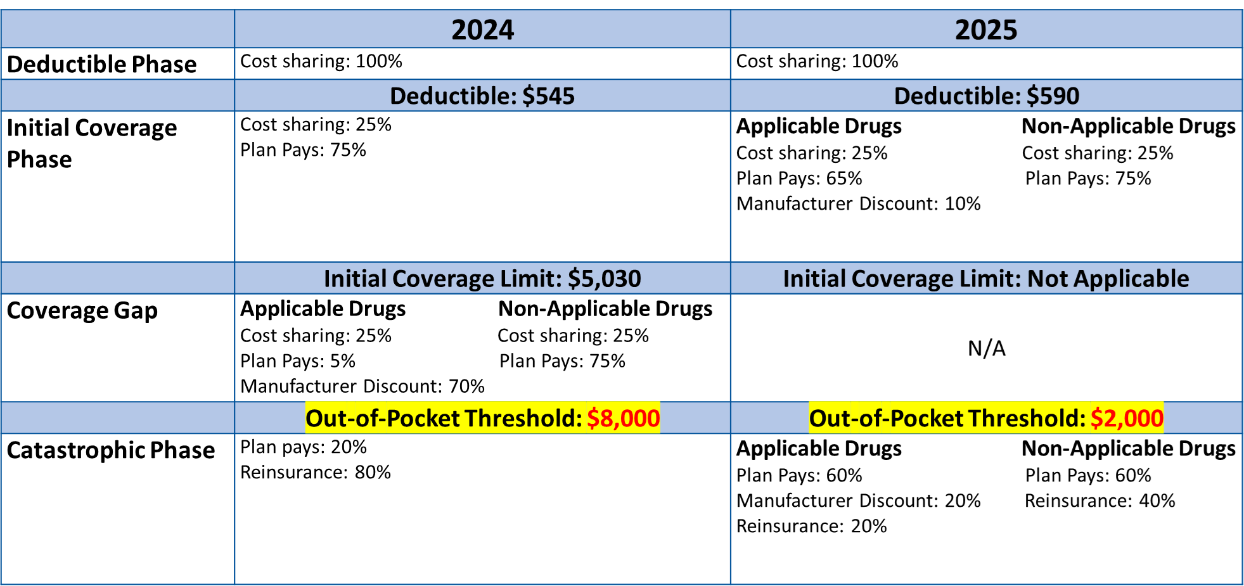

Slide 6
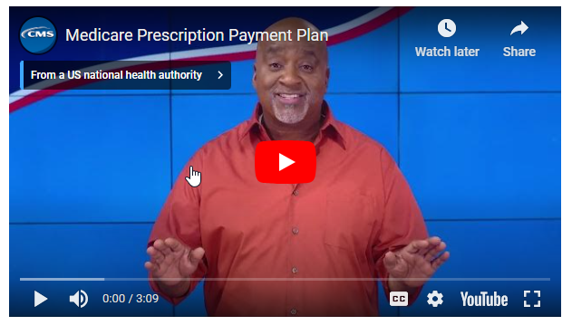
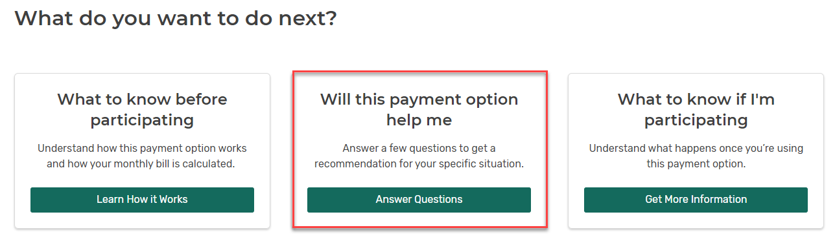
Medicare Prescription Payment Plan
https://www.medicare.gov/prescription-payment-plan
MPPP

Slide 7
Medicare Prescription Payment Plan
The Medicare Prescription Payment Plan was established by section 11202 of the Inflation Reduction Act of 2022 (IRA) (P.L. 117-169) and signed into law on August 16, 2022.
The IRA makes Medicare stronger for current and future enrollees. It makes health care more accessible, equitable, and affordable. Section 1860D-2(b)(2)(E) of the Social Security Act (the Act), as added by section 11202 of the IRA, requires all Medicare prescription drug plans to offer their Part D enrollees the option to pay their out-of-pocket (OOP) Part D drug costs through monthly payments over the course of the plan year instead of as upfront payments at the pharmacy point of sale (POS) beginning January 1, 2025. This provision applies to all Part D sponsors,14,15 including both stand-alone Medicare prescription drug plans (PDPs) and Medicare Advantage (MA) plans with prescription drug coverage (MA-PDs), as well as Employer Group Waiver Plans (EGWPs), cost plans, and demonstration plans.
CMS Website w/Guidance: https://www.cms.gov/inflation-reduction-act-and-medicare/part-d-improvements/medicare-prescription-payment-plan

Slide 8
Medicare Prescription Payment Plan
During the fourth quarter of the year, Part D sponsors must review their Part D claims history from the first three quarters of the year to identify Part D enrollees likely to benefit in the upcoming year. Based on this analysis and any additional analysis plan sponsors conduct to identify enrollees who may be likely to benefit from this program, the plan sponsor must send the “Medicare Prescription Payment Plan Likely to Benefit Notice” to identified enrollees no later than the end of the Annual Election Period (open enrollment), which is December 7 of each year. For CY 2025, Part D sponsors must assess claims for covered Part D drugs with dates of services from January through September 2024 and send the “Medicare Prescription Payment Plan Likely to Benefit Notice” in October, November, or early December 2024 (no later than December 7, 2024).

Slide 9
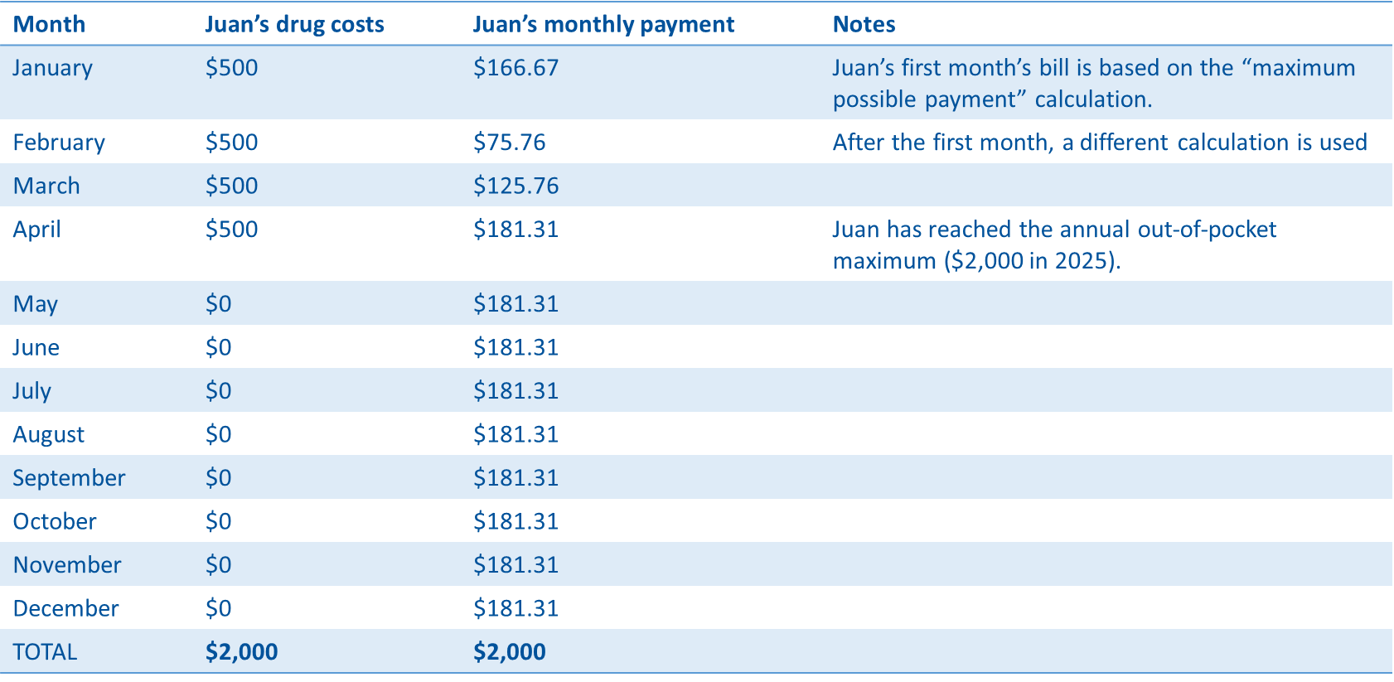

Slide 10
Presenter Notes​
Example #1: Juan has Medicare Part D and takes several high-cost drugs that have a total out-of-pocket cost of $500 each month. He starts the Medicare Prescription Payment Plan in January 2025.
Calculation of “maximum possible payment” for the first month: His first month’s bill in the Medicare Prescription Payment Plan is calculated differently than his bills for the rest of the months in the year.
First, we figure out Juan’s maximum possible payment: Juan has had no prior pharmacy expenditures in 2025; therefore, he doesn't have out-of-pocket costs before using this payment option, $0. The annual out-of-pocket maximum in 2025 is $2,000. $2,000 - $0 = $2,000. Divide by the remaining months in the year (12) to get a maximum monthly payment for the first month of $166.67.
Then, we figure out what Juan will pay for January: Compare Juan’s total out-of-pocket costs for January ($500) to the “maximum possible payment” of $166.67. The plan will bill for the lesser of the 2 amounts ($166.67). His remaining balance is $333.33 ($500-166.67).
Calculation of payment for February and the rest of the months left in the year: Juan goes to the pharmacy in February to fill a $500 prescription.
Step 1: Determine the remaining any remaining balance. Juan’s remaining balance from January is $333.33 ($500-$166.67).
Step 2: Determine the new out-of-pocket costs for the refill ($500). Juan’s new total owed is $833.33 ($333.33 + $500). Divide the new total by the remaining months (11) to get his February payment of $75.76.
Step 3: Calculate the payment for each subsequent month. In March, the months remaining in the plan year equals 10. The remaining balance is $757.57. New costs are $500. So, $757.57 + $500= $1,257.57. Divide by 10 (remaining months) to get the payment of $125.76. The calculation for monthly payments in subsequent months, described above, is repeated for each month remaining in the plan year and will change if there are additional out-of-pocket costs. If Juan continues his $500 monthly prescription, he’ll reach the out-of-pocket maximum of $2,000 in April and won’t have new out-of-pocket drug costs for the remainder of the calendar year. His monthly payment amount addresses the remaining balance. He pays a total of $2,000 for the year regardless of whether he selected the payment option.
If Juan is concerned about paying $500 each month from January to April, this payment option will help him manage those costs. If he prefers to pay $500 each month for 4 months and then pay $0 for the rest of the year, this payment option may not be the right choice for him. He should contact his health or drug plan for personalized help.
Sources: CMS.gov/files/document/monthly-cap-cost-sharing-technical-memo-july-2023.pdf and CMS.gov/inflation-reduction-act-and-medicare/part-d-improvements/medicare-prescription-payment-plan.

Slide 11
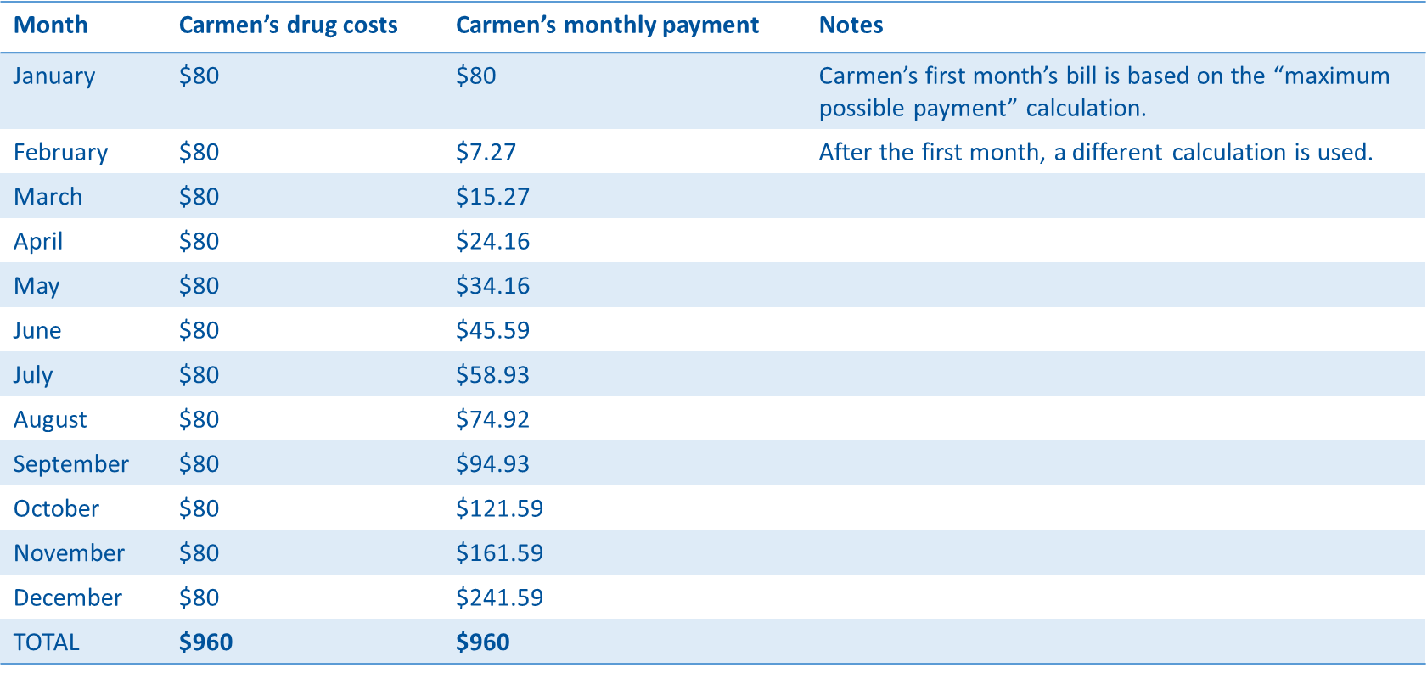

Slide 12
Presenter Notes​
Calculation of “maximum possible payment” for the first month: Carmen started participating in the Medicare Prescription Payment Plan in January. She goes to the pharmacy in January 2025 to fill 4 prescriptions totaling $80.00 out of pocket. Carmen’s maximum possible payment for the first month is the result of subtracting any prior balance ($0 for Carmen) from the annual out-of-pocket maximum ($2,000 for 2025). ($2,000 - $0 = $2,000). There are 12 months remaining in the year because she joined during OEP for January of the following year ($2,000/12= $166.67 is Carmen’s maximum possible payment for the first month. Compare Carmen’s total out-of-pocket costs for January ($80) to the “maximum possible payment” of $166.67. The plan will bill for the lesser of the two amounts ($80).
Calculation of payment for February and the rest of the months left in the year: Carmen refills all four of her existing prescriptions in February.
Step 1: Determine the remaining balance. Carmen paid her out-of-pocket costs in full in January ($80). As a result, she has a remaining balance of $0.
Step 2: Add any new out-of-pocket costs for that month. She refills 4 prescriptions with a copays totaling $80.
Step 3: For February and the remaining months of the year, calculate Carmen’s payments by adding new monthly costs to any remaining balance, then divide the total by the number of remaining months in the year. In February, 11 months remain in the plan year; ($0 + $80.00)/11 = $7.27
In March, Carmen again pays $80 out-of-pocket for her 4 prescriptions. Her remaining balance from February is $72.73 ($80 - $7.27 = $72.73). Her March payment is calculated by adding her new costs to her remaining balance ($80 + $72.73 =$152.73). The total is divided by the number of months remaining in the year (10). So, $152.73 / 10 = $15.27. Repeat this process for each month. The resulting payments are displayed on the slide. Carmen will pay the same total amount out-of-pocket for the year regardless of whether she uses the Medicare Prescription Payment Plans. Carmen’s payment varies each month. She may prefer to pay $80 each month for payment predictability. Regardless, she’ll never pay more than:
The total amount she would have paid out-of-pocket.
The total annual out-of-pocket maximum ($2,000 in 2025).
Depending on your specific circumstances, you may not benefit from using this payment option due to the higher payments later in the year. Contact your health or drug plan for personalized help. In particular, for people with Extra Help (also known as LIS), enrollment in Extra Help is more advantageous than the Medicare Prescription Payment Plan.
Sources: CMS.gov/files/document/medicare-prescription-payment-plan-final-part-one-guidance.pdf and CMS.gov/inflation-reduction-act-and-medicare/part-d-improvements/medicare-prescription-payment-plan.

Slide 13
Medicare Prescription Payment Plan
During AEP plan review:
High-cost meds? Use Payment Plan option in Plan Finder to show estimated monthly costs
Note: POS Threshold for Out-of-Pocket Costs: CMS has revised section 60.2.3 to state that Part D sponsors and pharmacies must use a $600, single prescription POS threshold to identify enrollees likely to benefit. CMS chose a single prescription drug cost POS threshold of $600 because this approach identifies Part D enrollees with a very high likelihood (~98%) of benefiting from the Medicare Prescription Payment Plan program, while reducing the risk of identifying Part D enrollees for whom the program may not be as helpful.
Explain to beneficiary to notify plan about wanting to opt in prior to beginning of year (so they don’t have high cost at pharmacy right away in January) – Enrollment Confirmation Page will have information/link to see costs
Plan has 10 days to process payment plan application if prior to coverage starting
Plan has 24 hours to process payment plan application if in middle of coverage

Slide 14

Questions or Thoughts?

Slide 15
LIS (Extra Help)
SEP Changes
CMS revised the current Part D quarterly (effect. 2019) Special Enrollment Period (SEP) for dually eligible, and other Part D low-income subsidy (LIS)-enrolled individuals, to a once-per-month SEP to enroll in a standalone prescription drug plan
Beginning in 2025, the monthly dual eligible/LIS SEP will allow a once-per-month election to leave an MA-PD for Original Medicare and a standalone drug plan or switch between standalone drug plans
It will no longer permit an SEP enrollment into Medicare Advantage Plans with Drug Coverage (MA-PD) or changes between MA-PD plans
New integrated care SEP will allow full-benefit dually eligible individuals to enroll monthly into a fully integrated dual eligible special needs plans (FIDE SNP) to facilitate aligned enrollment with the Medicaid managed care organization

Slide 16
Full-Dual
SEP Changes
CMS established a new integrated care SEP to allow full-benefit dually eligible individuals to elect an integrated dual eligible special needs plan (D-SNP) when the individual also receives Medicaid services through an affiliated Medicaid managed care plan
Beginning in 2025, the new integrated care SEP will allow full-benefit dually eligible individuals to enroll monthly into a fully integrated dual eligible special needs plans (FIDE SNP)
Collectively, the SEP changes will simplify and reduce confusion around SEP usage, reduce incentives for aggressive sales tactics targeting dually eligible individuals, and create more opportunities for enrollment into integrated D-SNPs where they are available

Slide 17
Telehealth Changes
Currently, you can get telehealth services at any location in the U.S., including your home (through December 31, 2024).
Beginning January 1, 2025, you must be in an office or medical facility located in a rural area for most telehealth services. However, you can still get certain telehealth services (like for mental and behavioral health) in your home no matter where you live.

Slide 18
Postal Service Retirees
Starting January 1, 2025, U.S. Postal Service employees, retirees and their families will get coverage through a new benefits program instead of through the Federal Employee Health Benefits program.
Postal Service annuitants who retire and become eligible for Medicare after December 31, 2024, and their eligible family members will be required to enroll in Medicare Part B as a condition of eligibility for PSHB

Slide 19

Questions?

