Slide 1






New to Medicare –
Question we should be asking

Slide 2
New To Medicare
New To Medicare (NTM) Counseling Appointment –
Where do we start?
Where should we start?

Slide 3
EGHP (Employer Group Health Plan)
COBRA
Retiree/Union Coverage
Veterans Administration
Tricare (for Life)
FEHB (Federal Employee Health Benefits)
PSHB (Postal Service Health Benefits)
Affordable Care Act (aka ObamaCare, Your Health Idaho, Marketplace Plans)
Title
Here
Most Common NTM Situations

Slide 4

Employer Group Health Plan
One in five people 65 or older in the U.S. are in the workforce, more than double the number from 35 years ago, according to the Pew Research Center.

Slide 5
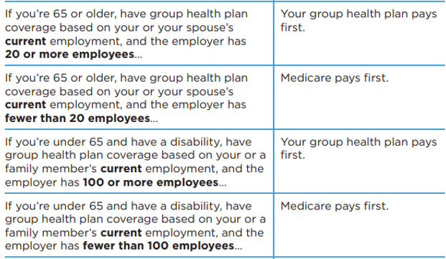
Employer Group Health Plan

Slide 6
Employer Group Health Plan
Question: Can an employer group health plan with a company larger than 20 persons, act as secondary policy with Original Parts A and B?
Answer: No. Medicare coordination of benefits rules say that insurance from a company with more than 20 employees pays primary. The employer or the insurer cannot choose to be secondary insurance.
Question: If someone is eligible for Medicare and works for a company with fewer than 20 employees, and the company is willing to continue that person on the health plan, is that okay? Or does the employee have to enroll in Medicare?
Answer: When someone becomes eligible for Medicare due to age and works for a company with fewer than 20 employees, then their employer coverage is secondary, and Medicare is primary. This means they should enroll in Medicare so that they have primary insurance. They can also keep their employer insurance as secondary.
Question: A client's employer has only five employees. When client turned 65 (two years ago), employer told him they would continue his health insurance, and they said he did not have to enroll in Medicare. Does client need to do something to ensure he does not have a penalty when he retires?
Answer: As long as someone uses the Part B SEP to enroll in Medicare, they should not have a penalty. Someone qualifies to use the Part B SEP if they have insurance from current work (from their job, their spouse’s job, or sometimes a family member’s job) or have had such insurance within the past eight months.
Question: If group health plan (GHP) agrees to pay primary (even if they are not required to), and later goes out of business or drops coverage, does an individual have a Part B SEP?
Answer: Yes, an individual has a Part B SEP in that situation. That’s because someone’s ability to use the Part B SEP is based on whether they are currently working and covered by insurance based on current work, not on whether their insurance was paying primary or not.
Someone can use the Part B SEP regardless of the size of their employer.
Whether or not Medicare is primary does not determine whether someone has an LEP or not. But it does affect a beneficiary’s decision to enroll in Medicare. Since the employer has fewer than 20 employees, the job-based insurance is not obligated to pay primary; it is secondary according to Medicare coordination of benefits rules. As such, the client may want to get something in writing from the employer that confirms the employer insurance will continue paying primary even though it doesn’t have to. When an employer group health plan pays primary when it doesn’t have to, there’s the risk that at some point the plan or employer may decide to stop paying primary, and it could also recoup past payments it made as primary insurance.

Slide 7
Health Savings Account (HSA)
If you enroll in Medicare Part A and/or B, you can no longer contribute pre-tax dollars to your HSA.
If you delay enrollment due to working and contributing to your HSA, you must also wait to collect SS retirement benefits (This is because most individuals who are collecting Social Security benefits when they become eligible for Medicare are automatically enrolled into Medicare Part A. You cannot decline premium-free Part A while collecting Social Security benefits).
You should delay SS benefits/Part A enrollment if you wish to continue contributing funds to your HSA.
If you delay enrolling in Medicare, make sure to stop contributing to your HSA at least six months before you do plan to enroll in Medicare. When you enroll in Part A, you receive up to six months of retroactive coverage, not going back farther than your initial month of eligibility.
Consult a tax professional; you may incur a tax penalty.

Slide 8
COBRA
Consolidated Omnibus Budget Reconciliation Act
Requires employers with 20 or more employees to let employees and dependents keep health coverage under certain conditions
Allows certain former employees, retirees, spouses, former spouses, and dependent children the right to temporary continuation of health coverage at group rates
If you have COBRA when you become Medicare-eligible, your COBRA coverage usually ends on the date you get Medicare. A spouse and dependents may keep COBRA for up to 36 months.
If you have Medicare Part A or Part B when you become eligible for COBRA, you must be allowed to enroll in COBRA. Medicare is your primary insurance, and COBRA is secondary. You should keep Medicare because it is responsible for paying the majority of your health care costs.
If You | Medicare Pays First
Are 65 or older or have a disability and have COBRA continuation coverage | In most cases
Have COBRA continuation coverage and are eligible for Medicare due to ESRD | When your 30-month coordination period ends

Slide 9
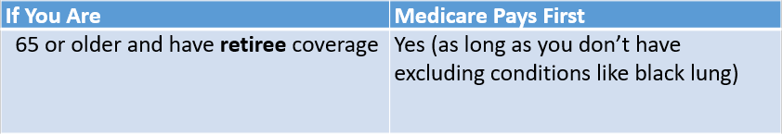
Retiree/Union Plan
Clarify that it is retiree coverage
May have specific enrollment/disenrollment periods (NOT in line with Medicare’s enrollment/disenrollment periods)
Is it creditable drug coverage?

Slide 10
VA (Veterans Administration)
Medicare and VA don’t work together (no primary/secondary coverage)
Medicare Advantage Plans may be a good option -
1. MA Plans w/no drug coverage have low to $0 premium
2. Gives a veteran access to local providers not connected with the VA
3. Provides the extra benefits (i.e. dental, vision, etc.)
Creditable Coverage? No – Part B (penalty for not having Part B if outside their IEP)
Yes – Part D

Slide 11
TFL (Tricare For Life)
Medical coverage for Medicare-eligible uniformed services retirees 65 or older, their eligible family members and survivors, and certain former spouses
  Medicare pays first and TFL pays second
  For services covered by TFL but not Medicare TFL pays first and Medicare pays nothing
  For services you get in a military hospital TFL pays first and Medicare generally pays nothing
Advantage Plans – not needed for medical but some may want for Extra Benefits (dental, vision, etc). There will be Advantage Plan network situations and for uncovered medical they may need to file paperwork with TFL for reimbursement (including drug co-pays)
Many Advantage plans provide drug coverage. TFL members probably won’t want MAPD coverage. Because TRICARE always pays last, you may find yourself filing manual claims to exercise TRICARE drug coverage.

Slide 12
FEHB (Federal Employee Health Benefits)
You don't have to take Part B coverage if you don't want it, and your FEHB plan can't require you to take it. There are some advantages to enrolling in Part B:
Your FEHB plan may waive its copayments, coinsurance, and deductibles for Part B services.
Some services covered under Part B might not be covered or only partially covered by the FEHB plan, such as orthopedic and prosthetic devices, durable medical equipment, home health care, and medical supplies.
May go outside of the FEHB plan's network for Part B services and receive reimbursement by Medicare (only when Medicare is the primary payer) if you are enrolled in an FEHB HMO.
Creditable Coverage? No – Part B (penalty for not having – if they enroll outside their IEP)
Yes – Part D

Slide 13
PSHB (Postal Service Health Benefits)
Starting January 1, 2025, U.S. Postal Service employees, retirees and their families will get coverage through a new benefits program instead of through the Federal Employee Health Benefits program.
Postal Service annuitants who retire and become eligible for Medicare after December 31, 2024, and their eligible family members will be required to enroll in Medicare Part B as a condition of eligibility for PSHB

Slide 14
Affordable Care Act Plan
Loss of Tax Credits – resulting in full premiums (screen for MSP/LIS eligibility)
Cannot enroll in ACA Plan if already in Medicare
Not creditable Part B or Part D coverage (penalties if enrolling after IEP)
If having to pay for Part A – can enroll in AFA plan…………….but would have penalties if enrolling in Part A later
Even if paying for Part A & Part B – may still be cheaper if they enroll in an MAPD

Slide 15
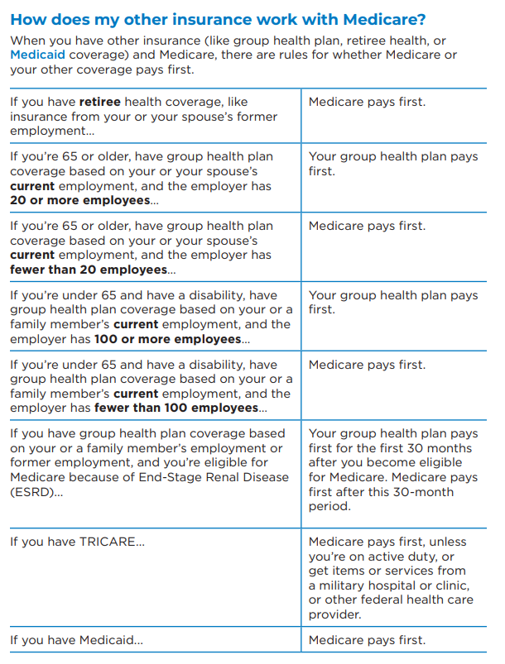
Medicare & You - 2025
Title
Here

Slide 16
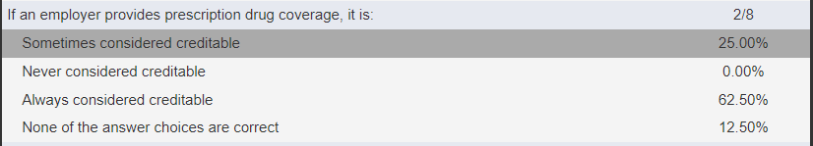
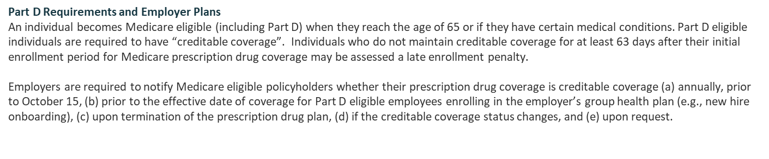
Creditable Coverage
Part D Max Out Of Pocket 2025 = $2,000 (2024 MOOP = $8,000)
Talk to beneficiaries/Medicare-eligible individuals – Obtain/keep letters of Creditable Coverage from employer, retiree, COBRA plans, etc.

Slide 17
This concludes this presentation
Title
Here

Slide 18

1
1
2
2
3
3
4
4
Notes:
Family Feud Template
Introduction Slide – The Countdown!

Slide 19

FAMILY FEUD FAMILY FEUD FAMILY FEUD FAMILY FEUD FAMILY FEUD FAMILY FEUD FAMILY FEUD FAMILY FEUD FAMILY FEUD FAMILY FEUD FAMILY FEUD FAMILY FEUD FAMILY FEUD FAMILY FEUD FAMILY FEUD FAMILY FEUD FAMILY FE
FAMILY FEUD FAMILY FEUD FAMILY FEUD FAMILY FEUD FAMILY FEUD FAMILY FEUD FAMILY FEUD FAMILY FEUD FAMILY FEUD FAMILY FEUD FAMILY FEUD FAMILY FEUD FAMILY FEUD FAMILY FEUD FAMILY FEUD FAMILY FEUD FAMILY FE
Notes:
Family Feud Template
Introduction Slide – Family Feud!

Slide 20







What should we be asking?
X
X
X
X
X
X
X
X
X
Are you working –
will you continue to work?
57
30
What is your current
coverage?
6
Do you have A and/or
B started?
Do you want to volunteer
for SHIBA?
3
X
X
X
Win
Lose
Cheer
Boo
Silence
Notes:
Family Feud Template
4 Panel Slide

Slide 21
Thank You!
SHIBA.idaho.gov
1-800-247-4422
This project was supported, in part by grant number 2202IDMISH, from the U.S. Administration for Community Living, Department of Health and Human Services, Washington, D.C. 20201.

